Slide 1


Mapping Hemochromatosis Genes using a Novel Recessive Diplotype Approach in the Marshfield Clinic Personalized Medicine Research Project (PMRP)
Shicheng Guo
Center for Precision Medicine Research
Marshfield Clinic Research Institute
03/13/2019

Slide 2
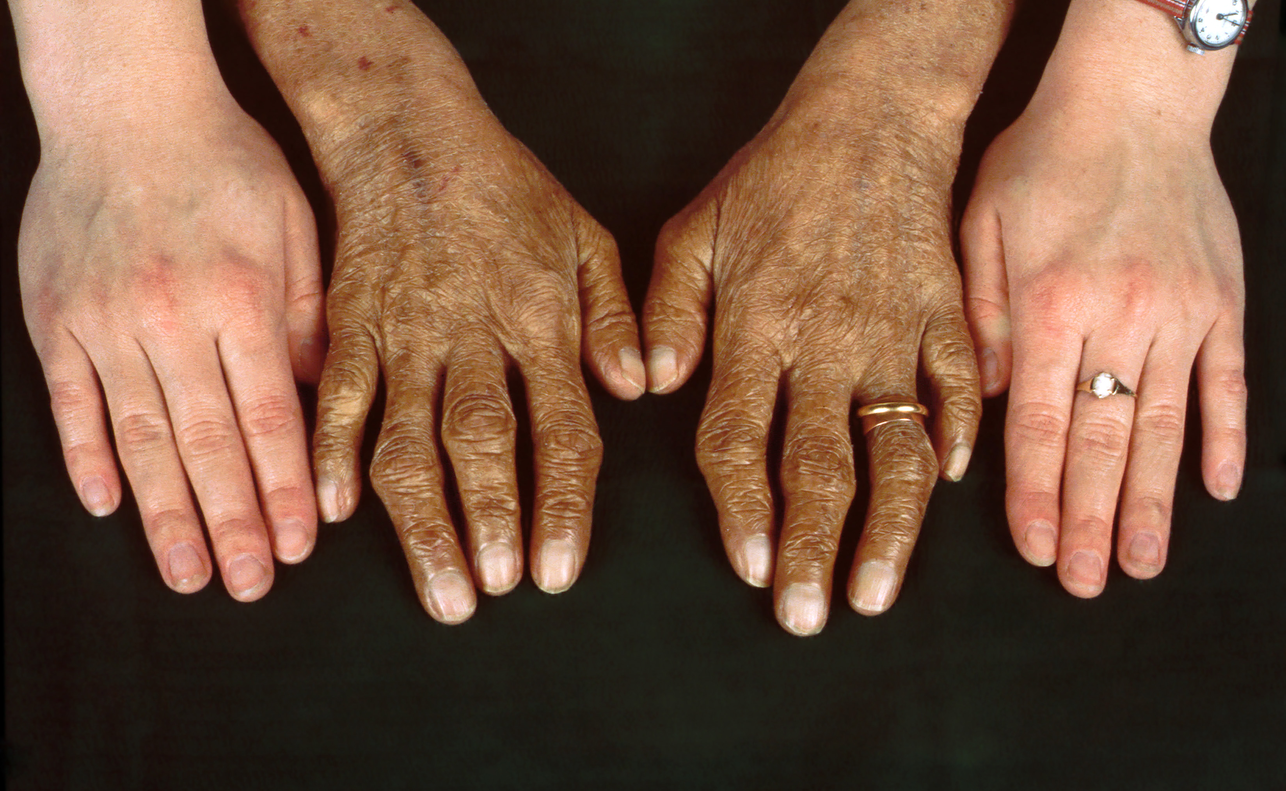
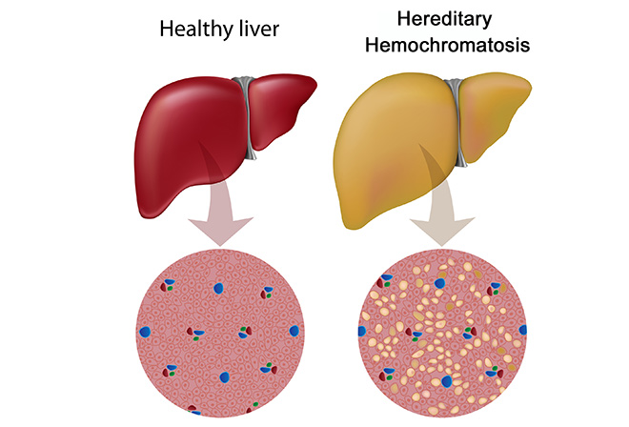
Hemochromatosis: clinical symptoms
Hereditary hemochromatosis (HH) is a genetic disorder characterized by excessive iron accumulation that results in multiple tissues damage
Skin bronzing or hyperpigmentation (70%)
Liver disease (hepatomegaly, 13%; cirrhosis, 13%)
Diabetes mellitus (48%)
Arthropathy
Amenorrhea, impotence, hypogonadism
Grey’s Anatomy: https://www.youtube.com/watch?v=H4SAK7vgfUo
Notes:
Hereditary hemochromatosis is a genetic disorder characterized by excessive iron (Fe) accumulation that results in tissue damage. Manifestations can include systemic symptoms, liver disorders, cardiomyopathy, diabetes, erectile dysfunction, and arthropathy. Diagnosis is by elevated serum ferritin, iron, and transferrin saturation levels and confirmed by a gene assay. Treatment is usually with serial phlebotomies. The most common clinical symptoms are skin bronzing and liver diseases.

Slide 3
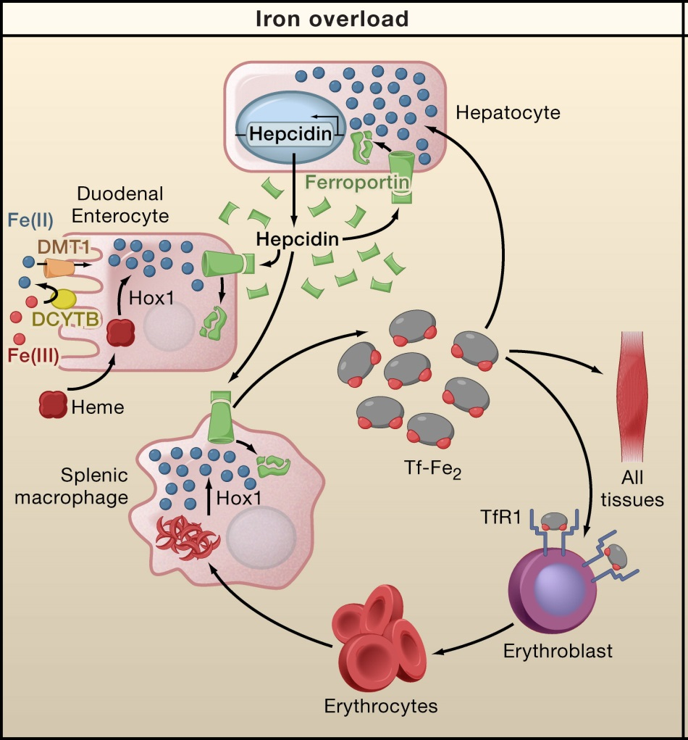
Human iron metabolism and iron homeostasis
Liver cells
Storage and Regulation
HAMP
Intestinal mucosal cells
Iron Absorption
SLC40A1
Blood Cells
Storage and Transport

Slide 4
Genetic etiology of hemochromatosis
 | Type 1 | Type 2A | Type 2B | Type 3 | Type 4
Name | Classic HHC | Juvenile HHC | Juvenile HHC | TfR2-related HHC | Ferroportin-related iron overload
Gene | HFE | HJV | HAMP | TfR2 | SLC40A1
Protein Produced | HFE | Hemojuvelin | Hepcidin | Transferrin receptor 2 | Ferroportin (iron regulatory protein)
Inheritance | autosomal recessive | autosomal recessive | autosomal recessive | autosomal recessive | autosomal dominant
Function | interruption of transferrin-bound iron, possible modulation of hepcidin regulation | unknown; possible hepcidin modulation | regulation of iron release in intestinal and blood cells | possible interference of iron uptake by liver cells | possible interference of iron export from intestinal, liver and placental cells
Organ Damage | variable | high | high | variable | low
Age of Onset | 40s or 50s | 20s or 30s | 20s or 30s | 40s or 50s | 40s or 50s

Slide 5
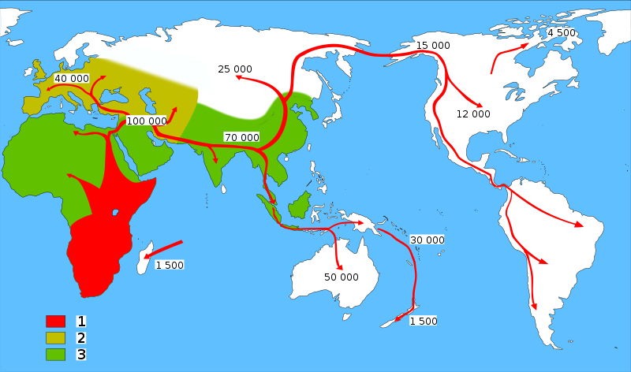
HFE-Hemochromatosis and Human migrations
Neolithic Agricultural Revolution
C282Y ~6000
HFE C282Y, ~6000 years ago
85–90%: Northern European Descent
60%: Mediterranean populations
0% in Asian population
The C282Y allele is the major cause of hemochromatosis as a result of excessive iron absorption. The mutation arose in continental Europe no earlier than 6,000 years ago, coinciding with the arrival of the Neolithic agricultural revolution.
Tsui WM, et al. The C282Y mutation of the HFE gene is not found in Chinese haemochromatotic patients: multicentre retrospective study. Hong Kong Med J 2000;6:153-158.

Slide 6
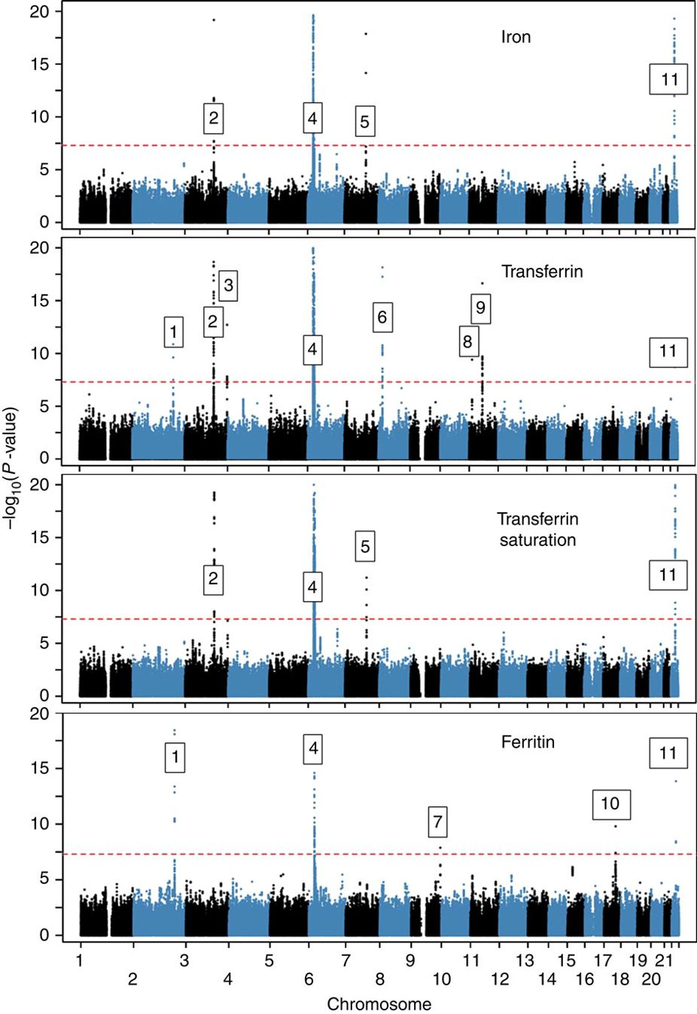
Novel loci affecting iron homeostasis and their effects in individuals at risk for hemochromatosis
HFE, HJV, HAMP, TFR2, SLC40A1
In 2014, Benyamin and colleagues: GWAS
Discovery: 23,986 samples
Validation: 24,986 samples
11 genome-wide-significant (P<5 × 10−8) loci, some including known iron-related genes (HFE, SLC40A1, TF, TFR2, TFRC, TMPRSS6) and others novel (ABO, ARNTL, FADS2, NAT2, TEX14).
Limitation: conventional statistic models
Benyamin B, Esko T, Ried JS, Radhakrishnan A, Vermeulen SH, Traglia M, Gogele M, et al. Novel loci affecting iron homeostasis and their effects in individuals at risk for hemochromatosis. Nat Commun 2014;5:4926.

Slide 7
Exome-wide, Gene-based Recessive Diplotype Scan
Single Site Recessive Effects
Recessive Diplotype
site by site
region by region
Gene-by-Gene Scanning to Identify Disease Genes

Slide 8
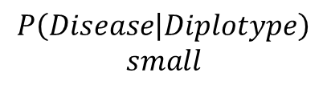
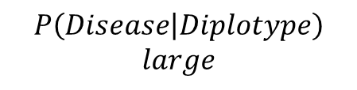
Recessive Diplotype Scan
Power calculations
2-locus model
Gene-based Monte Carlo
using 1000 Genomes
P₁₁
P₁₂
P₂₁
P₂₂
P₁₂ | P₁₂
P₁₁ | P₁₁
P₁₂ | P₂₁
P₁₁ | P₁₂
$$P\left(Disease | Diplotype\right)$$
$$small$$
P₁₂ | P₂₂
$$P\left(Disease | Diplotype\right)$$
$$large$$
P₁₁ | P₂₁
P₂₁ | P₂₁
P₁₁ | P₂₂
P₂₁ | P₂₂
P₂₂ | P₂₂

Slide 9
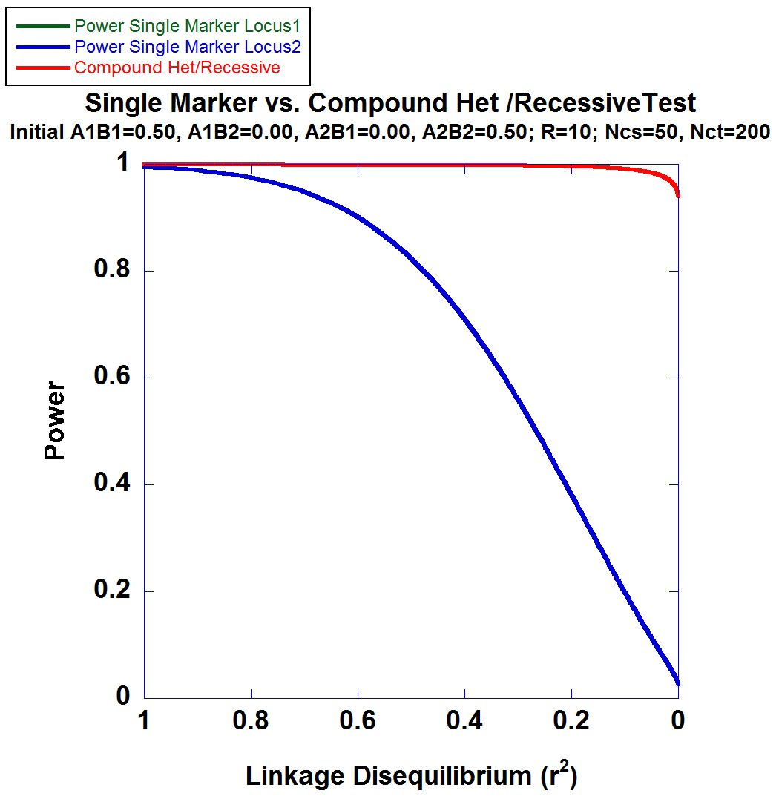
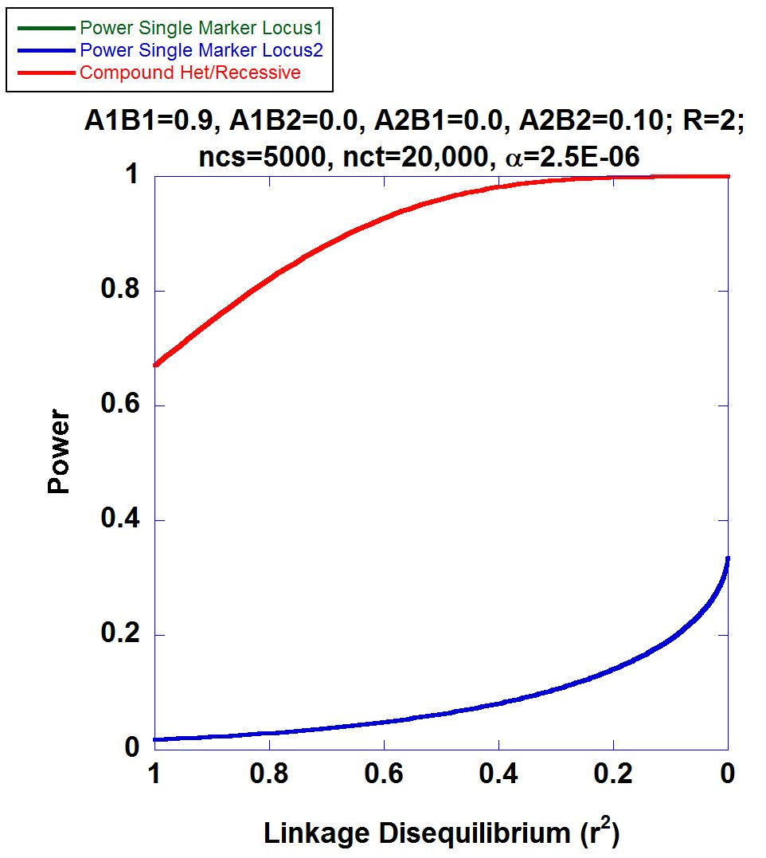
2-locus Power Calculations

Slide 10
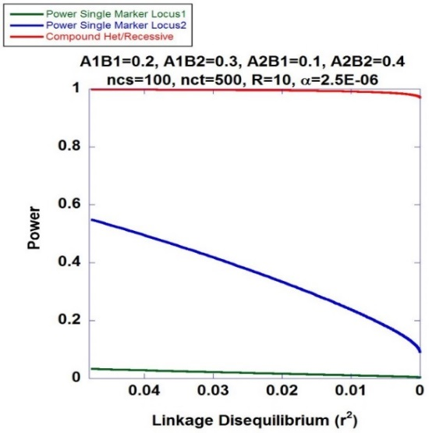
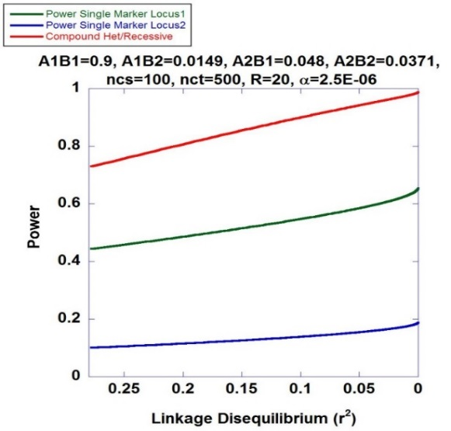
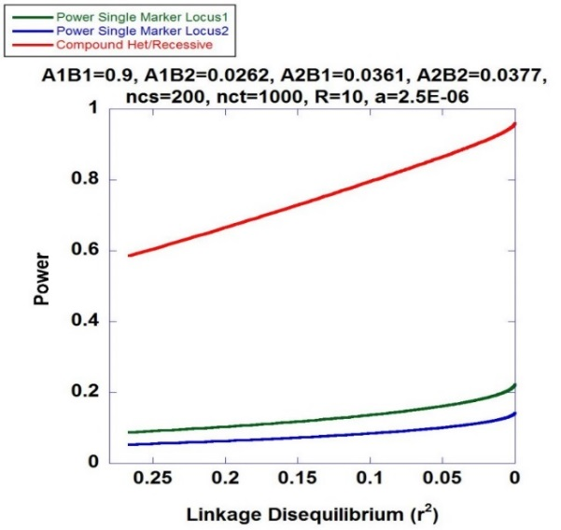
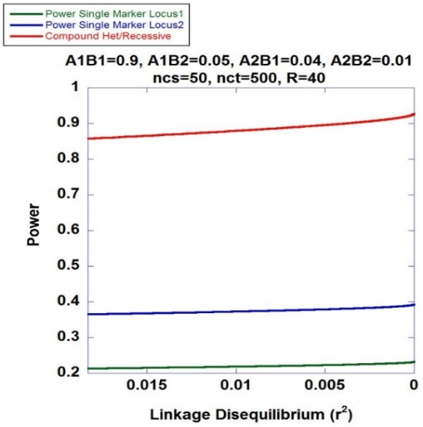
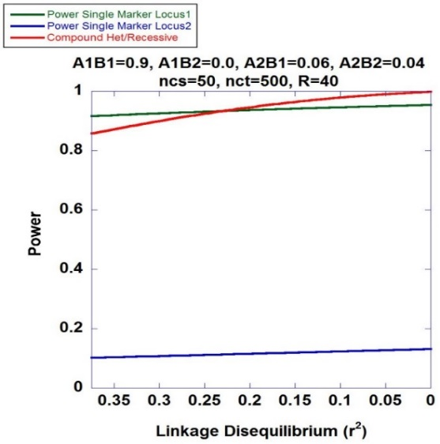
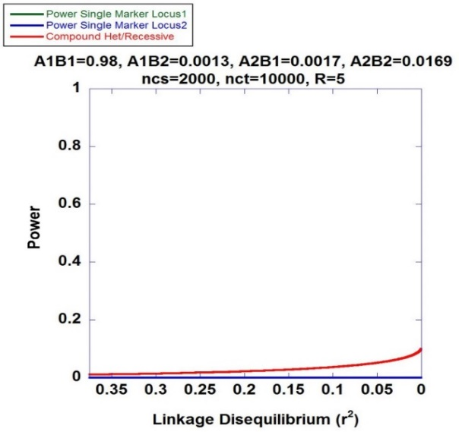
Higher Power of Recessive Diplotype Scan benefits PMRP
Recessive Diplotype approach always has higher power to identify the associated variants

Slide 11
Mapping Hemochromatosis Genes using a Novel Recessive Diplotype approach in PMRP
Exome beadchip data used on 10,000 subjects
PCA used to exclude genetic background outliers
Phasing using localized haplotype clustering
Putative functional variants: GWAS-significant, nonsynonymous, 3’UTR, 5’UTR, or splice site
Two or more in silico pathogenic annotations
ICD9: two or more instances of (i) iron metabolism disorder (ii) hereditary hemochromatosis, (iii) unspecified hemochromatosis
Transferrin saturation (ratio of serum iron to transferrin iron-binding capacity) > 48%
18 cases identified and 6,896 controls

Slide 12
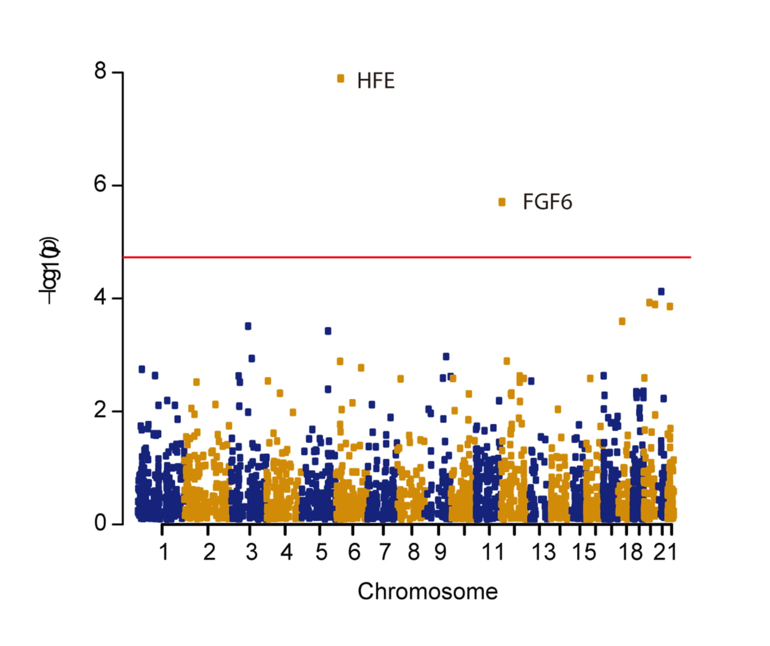
Manhattan Plot
CHR | GENE | P | OR#
chr6 | HFE | 1.29×10⁻⁸ | 28.6
chr12 | FGF6 | 1.99×10⁻⁶ | 22.8
chr21 | KRTAP15-1 | 7.55×10⁻⁵ | 6.78
chr20 | XKR7 | 1.18×10⁻⁴ | 43.6
chr20 | CABLES2 | 1.28×10⁻⁴ | 42.4
chr22 | THOC5 | 1.38×10⁻⁴ | 6.24

Slide 13
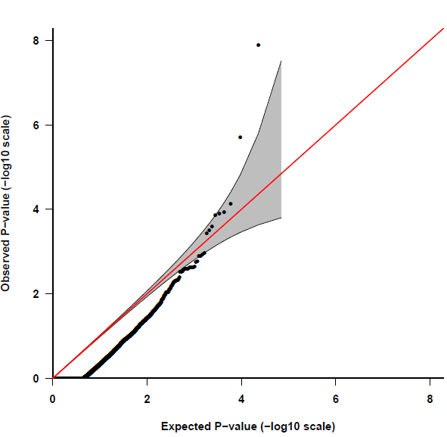
Quantile-Quantile Plot
HFE
FGF6
Fibroblast Growth Factor 6
Heparin-Binding Growth Factor 6
Heparin Secretory-Transforming Protein 2
FGF6
Poli M, Girelli D, et al. Heparin: a potent inhibitor of hepcidin expression in vitro and in vivo. Blood 2011;117:997-1004.

Slide 14
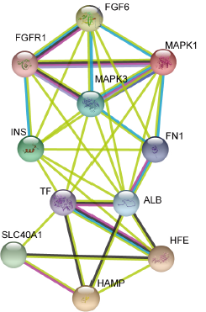
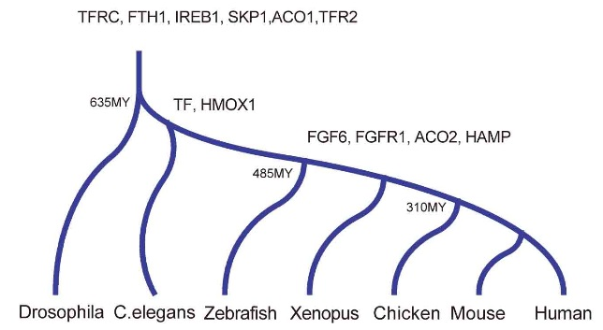
FGF6: molecular evolution and biological function
Encodes for the fibroblast growth factor 6 protein
Expressed across numerous tissues including skeletal muscle,
blood, liver and pancreas
Stage I: fundamental genes
Stage II: Regulatory Genes
Protein-protein interactions suggest
involvement of FGF-6 with Fe-metabolism
subnetwork

Slide 15
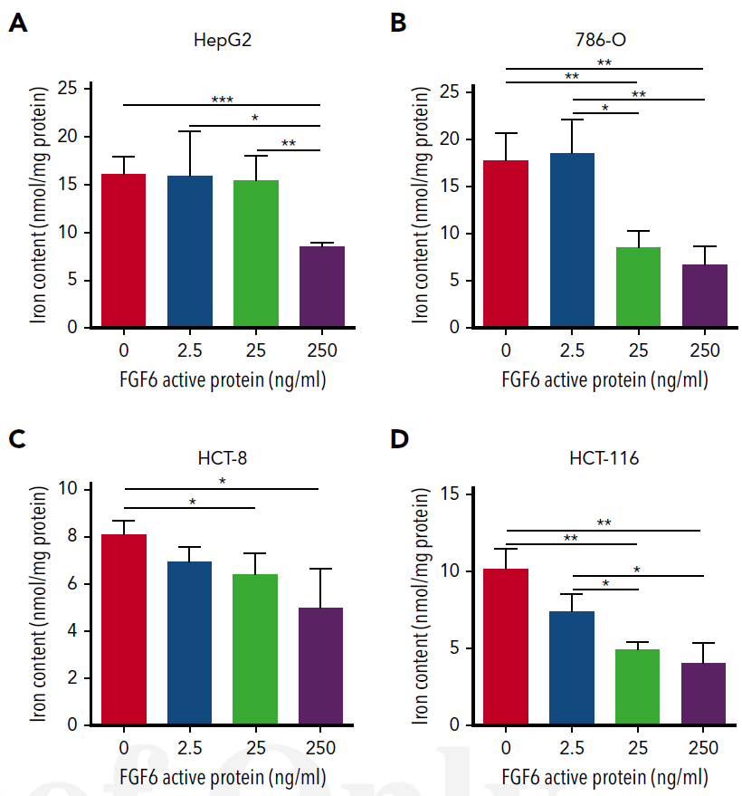
Dose-Dependent FGF-6 Impact on Intracellular Iron

Slide 16
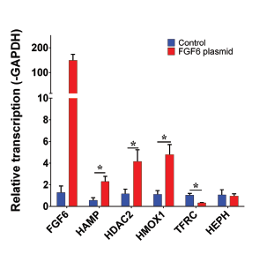
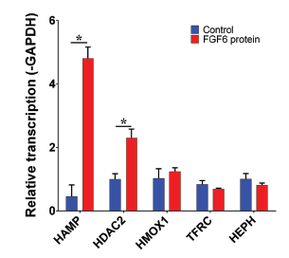
FGF-6 and FGF6 Transcriptional Regulation of Hepcidin (HAMP) in Hepatocytes
HAMP encodes for hepcidin
HDAC2 encodes for histone deacetylase 2
HMOX1 encodes for heme oxygenase 1
TFRC encodes for transferring receptor 1
HEPH encodes for hephaestin
Confirmed: FGF-6 could transcriptional regulate of Hepcidin (HAMP) in Hepatocytes
What is the biological Function of each variants?

Slide 17
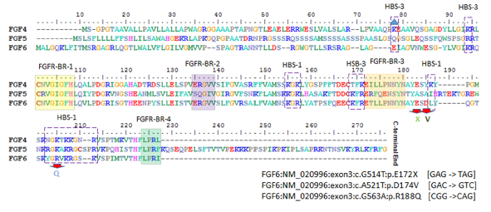
Evaluation of Three FGF6 Nonsynonymous Putative Functional Variants
Within or adjacent to heparin binding site motifs

Slide 18
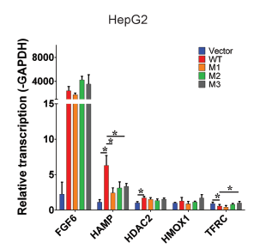
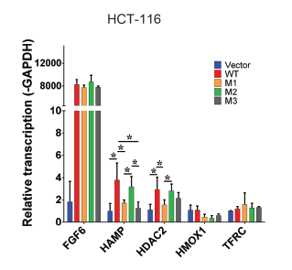
Variants Show Attenuation of Hepcidin Transcription Compared to Wildtype
M1: E172X
M2: D174V
M3: R188Q
Transfect FGF6 and variants into different cell lines

Slide 19
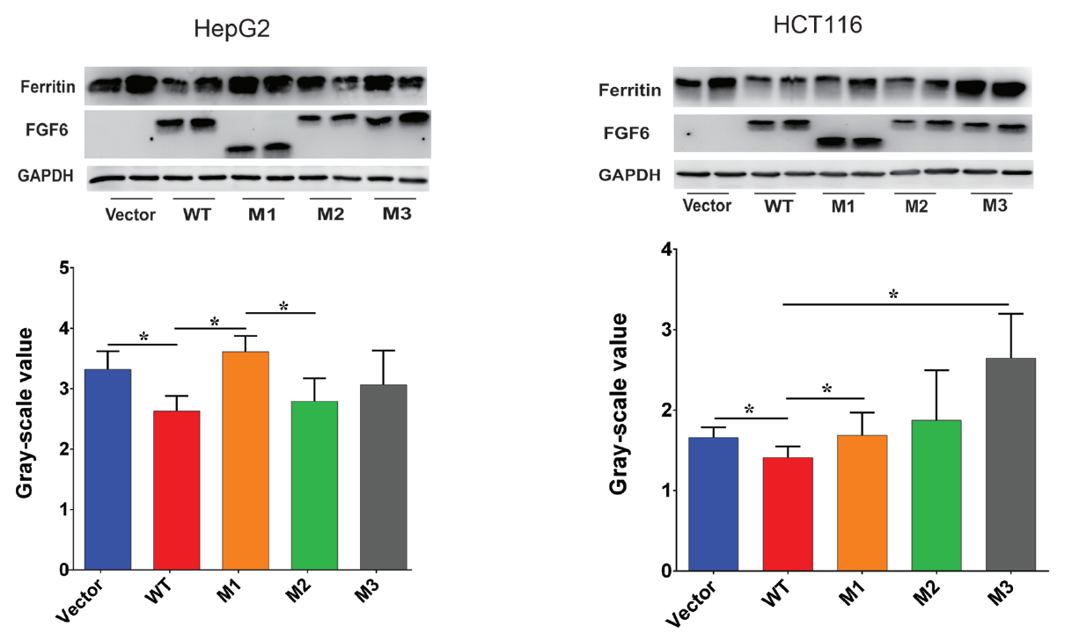
Variants Show Reduced Attenuation of Iron Uptake

Slide 20
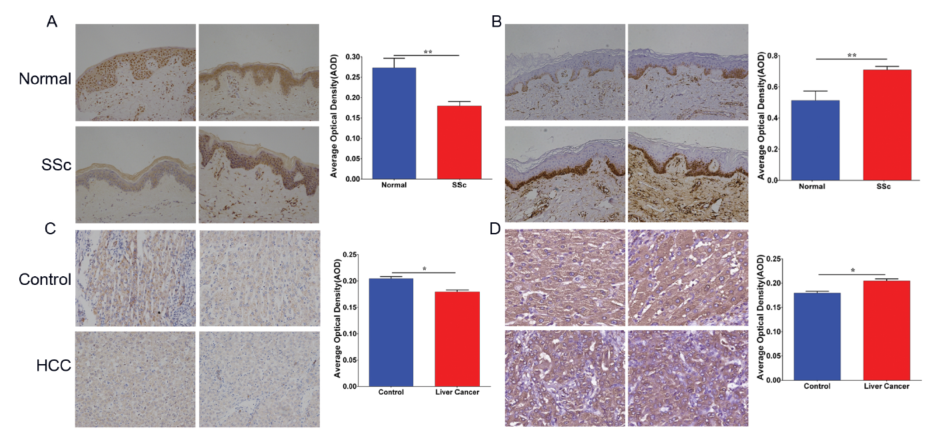
Low FGF6 expression and high iron deposition in liver cancer and systemic sclerosis (Immunohistochemistry, IHC)
FGF-6 protein level
Ferritin protein level

Slide 21
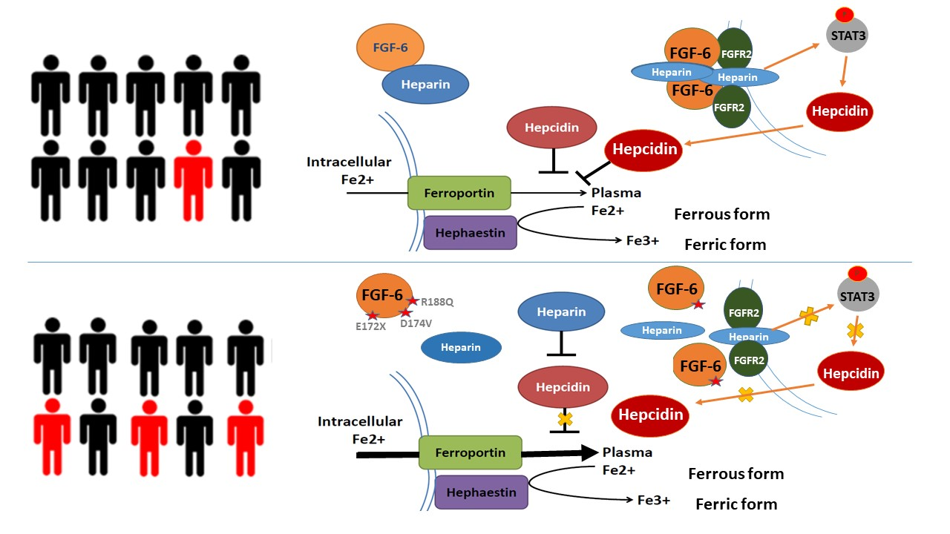
Marshfield Model: FGF6 decreases ferrous iron uptake in liver cells and induces increased hepcidin expression

Slide 22
Research contribution to clinical
 | Type 1 | Type 2A | Type 2B | Type 3 | Type 4
Name | Classic HHC | Juvenile HHC | Juvenile HHC | TfR2-related HHC | Ferroportin-related iron overload
Gene | HFE | HJV | HAMP | TfR2 | SLC40A1
Protein Produced | HFE | Hemojuvelin | Hepcidin | Transferrin receptor 2 | Ferroportin (iron regulatory protein)
Inheritance | autosomal recessive | autosomal recessive | autosomal recessive | autosomal recessive | autosomal dominant
Function | interruption of transferrin-bound iron, possible modulation of hepcidin regulation | unknown; possible hepcidin modulation | regulation of iron release in intestinal and blood cells | possible interference of iron uptake by liver cells | possible interference of iron export from intestinal, liver and placental cells
Organ Damage | variable | high | high | variable | low
Age of Onset | 40s or 50s | 20s or 30s | 20s or 30s | 40s or 50s | 40s or 50s
Type 5
FGF6-related iron overload
FGF6
Hepcidin and FGF6
CH recessive
?
?
?
1. Identified a new substype of hemochromatosis
2. More understanding to hemochromatosis
3, potential drug targets for the therapy of hemochromatosis

Slide 23

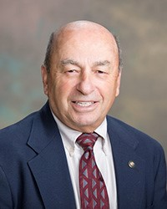
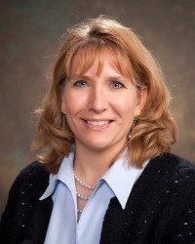
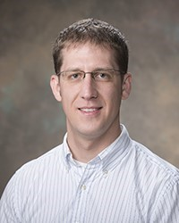



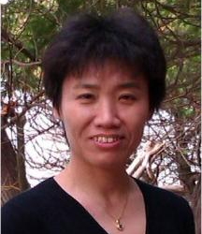
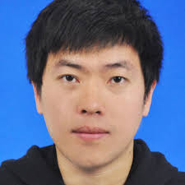


Acknowledgements
Dr. Steven Schrodi Dr. Joseph J. Mazza Dr.Jennifer K. Meece
Brent Olson, MRCI
Terrie Kitchner, MCRI
Jeffrey Joyce, MCRI
Robert Strenn, MCRI
Dr. Jiucun Wang
Fudan University
Dr. Shuai Jiang
Fudan University
Dr. Naren Epperla
Ohio State University
Dr. Judy Smith
UW-Madison

Slide 24
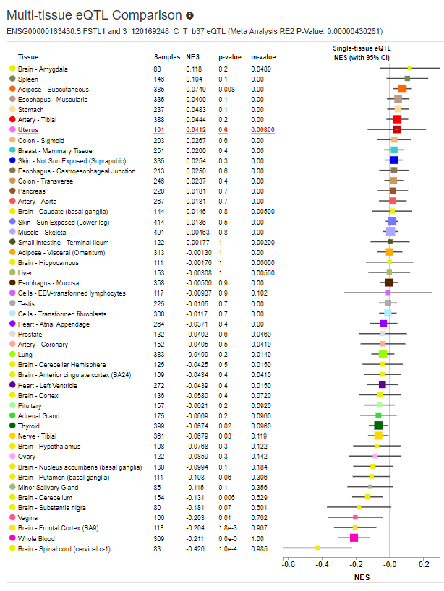
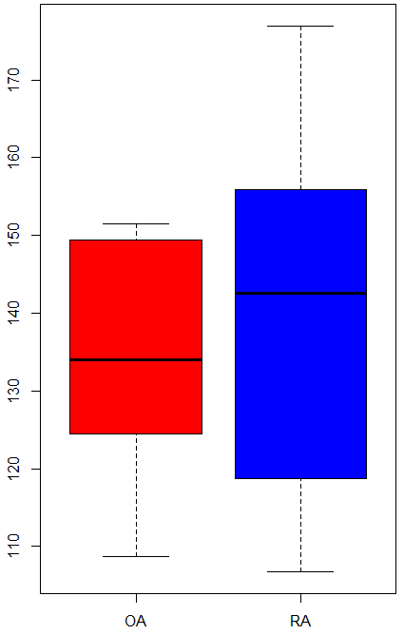
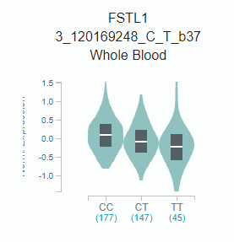
FSTL1 and Rheumatoid Arthritis
Follistatin also known as activin-binding protein is a protein that in humans is encoded by the FST gene. Follistatin is an autocrine glycoprotein that is expressed in nearly all tissues of higher animals.
rs1147707
FSTL1/Mean
RNA-seq data from GSE112658 (10 RA and 10 OA) shown FSTL1 is higher in RA compared with OA
Notes:
rs1147707, located in promoter region of FSTL1, is a cis-eQTL based on GTEx project, meanwhile, rs1147707 is identified by GWAS to be associated with blood pressure.

Slide 25
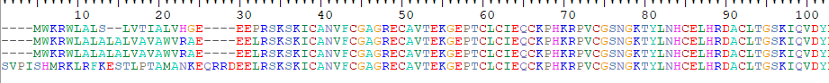
Protein sequence alignment for FSTL1 and functional domains
rs1147707 (eQTL)
Follistatin-N-terminal Domain-Like
Kazal-type Serine Protease Inhibitors Domain
rs374114238 (P>A)
rs199556968 (D>N)
_{Mus musculus}
_{Homo sapiens}
_{Pan troglodytes}
_{Puma concolor}
rs113155123 (E->G, Deleterious, WGAS)
EFh_SPARC_FSTL1
rs199863523 (N>D)
rs150197564 (R>C)
EF-hand domain
Von Willebrand Factor (vWF) type C Domain
rs754750214(E->K/Q)
TGF-beta, CD14, DIP2A, TLR4, Activin A, Activin B, Activin AB
(rs138798165)
(rs200530287)
FSTL1 contains 4 important domains: Follistatin-N-terminal Domain, Kazal-type serine protease inhibitor domain, EF-hand domain, vWF type C domain.
Follistatin-N-terminal Domain binds to activin and is a specific inhibitor of the biosynthesis and secretion of pituitary follicle stimulating hormone. Kazal-type inhibitors represent the most studied canonical proteinase inhibitors. vWF type C domain usually used to bind with other proteins.
Notes:
Kazal-type inhibitors represent the most studied canonical proteinase inhibitors. Kazal inhibitors are extremely variable at their reactive sites. However, some regularity prevails such as the presence of lysine at position P1 indicating strong inhibition of trypsin [(PUBMED:10708867)].
The Kazal inhibitor has six cysteine residues engaged in disulfide bonds arranged as shown in the following schematic representation:
+------------------+ | | *******************|*** xxxxxxxxCxxxxxxCx#xxxxxCxxxxxxxxxxCxxCxxxxxxxxxxxxxxxxxC | | | | | +-------------|-----------------+ +----------------------------+ 'C': conserved cysteine involved in a disulfide bond. '#': active site residue. '*': position of the pattern.
The structure of classical Kazal domains consists of a central alpha helix, which is inserted between two beta-strands and a third that is toward the C terminus [(PUBMED:6752426)]. The reactive site P1 and the conformation of the reactive site loop is structurally highly conserved, similar to the canonical conformation of small serine proteinase inhibitors.

Slide 26
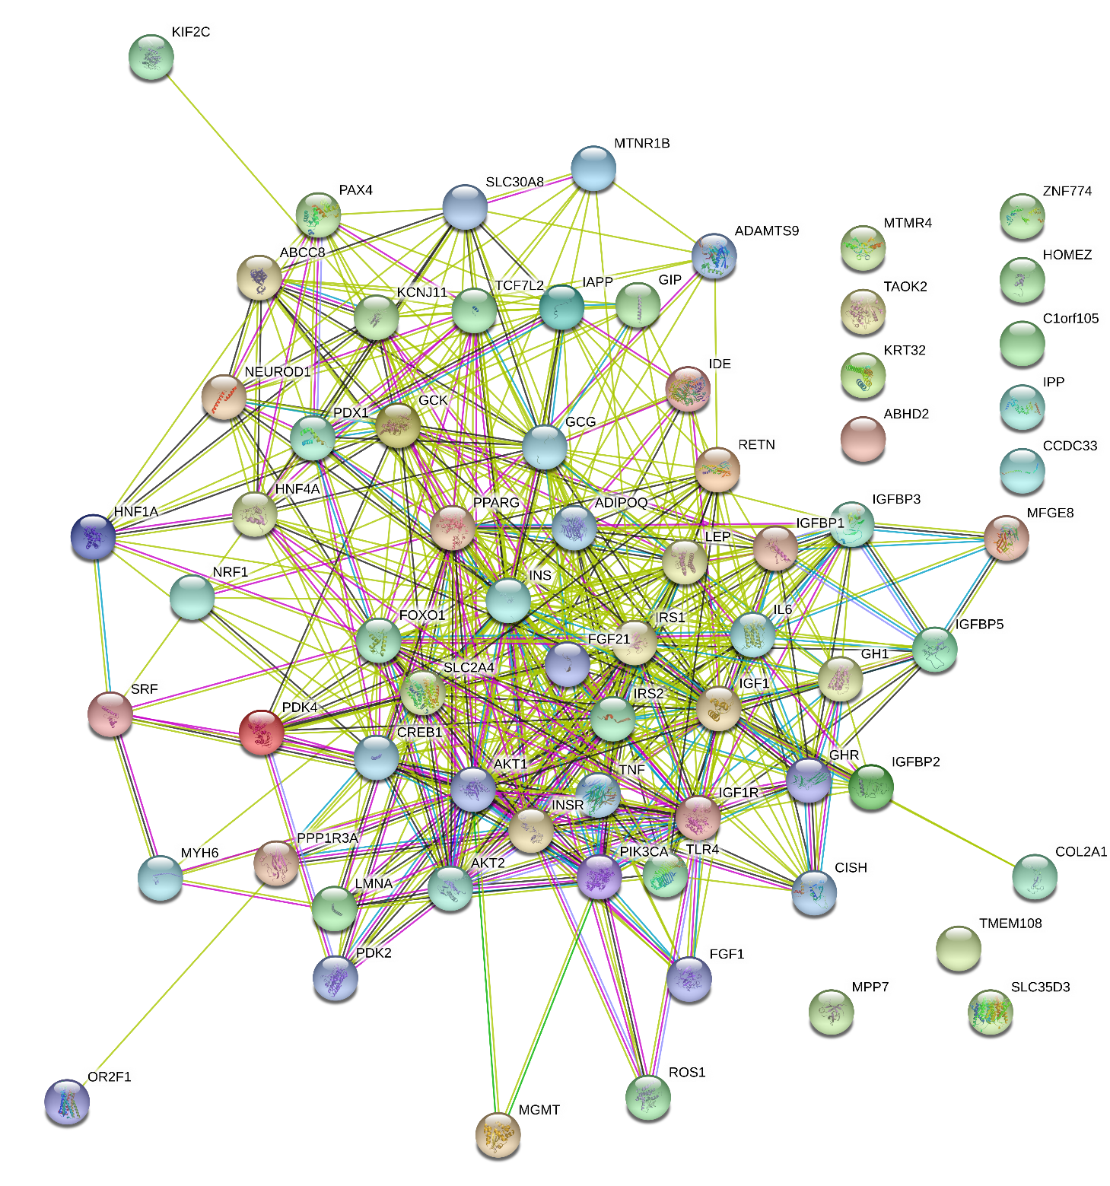
What we found in Marshfield Clinic PMRP Type 2 diabetes cohort
Symbol Pval UK-biobank GWAS
CREB1
With our new method, we identified 20 genes which are potential T2D associated genes. 5 of them have been identified in previous GWAS study and 7 of them are GWAS identified orthologous genes. 9 of them are UK-biobank significant T2D genes (without validation yet).
In this study, we are going to validate MTMR4, KIF2C, CCDCC33, MYH6 and COL2A1 with molecular and cellular approach. We selected these 5 genes since they are not novel genes and have certain evidence from UK-biobank (without validation yet). When we finish this project, 1) we validated our findings 2) we validated UK-biobank findings.
Green circle indicates this genes have evidence to be involved in T2D signaling pathway (above figure is protein-protein interaction (PPI) between T2D genes)
Notes:
With our new method, we identified 20 genes which are potential T2D associated genes. 5 of them have been identified in previous GWAS study and 7 of them are GWAS identified orthologous genes. 9 of them are UK-biobank significant T2D genes (without validation yet). In this study, we are going to validate MTMR4, KIF2C, CCDCC33, MYH6 and COL2A1 with molecular and cellular approach. We selected these 5 genes since they are not novel genes and have certain evidence from UK-biobank (without validation yet). When we finish this project, 1) we validated our findings 2) we validated UK-biobank findings.

Slide 27
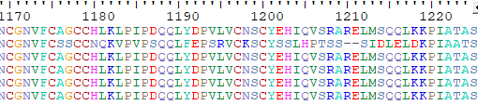
Figure 2. Protein sequence alignment for MTMR4 and functional domains
Pleckstrin Homology-Glucosyltransferases, Rab-like GTPase activators and Myotubularins domain (PH-GRAM)
Homo sapiens
Pan troglodytes
Pan paniscus
Gorilla
Pongo abelii
MTMR3
rs202018897
PTP-MTMR4
rs758600036
Myotub-related
rs759408312
rs139338138
FYVE Zinc Finger
(rs148437803)
(rs141377491)
(rs61740436)
(rs183891875)
(rs61740436)
(rs61742345)
rs149445881

Slide 28
Identification and Validation of Cell-free DNA Methylation Biomarker for Glioblastoma
Shicheng Guo
Center for Precision Medicine Research
Marshfield Clinic Research Institute
04/17/2019

Slide 29
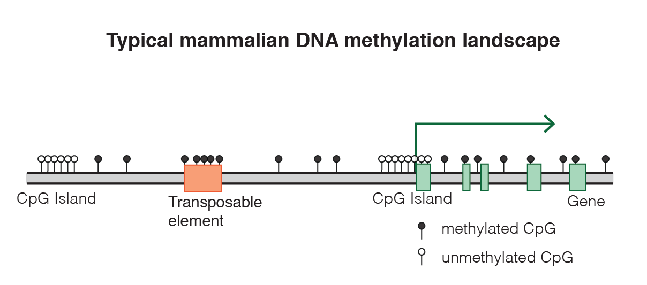
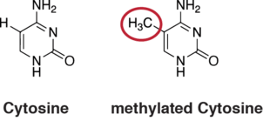
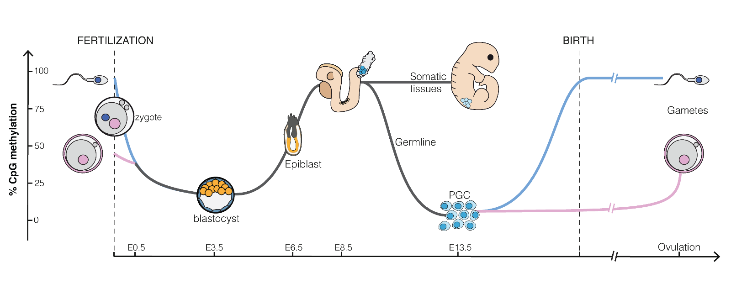
DNA methylation, gene expression and human development
https://en.wikipedia.org/wiki/DNA_methylation

Slide 30
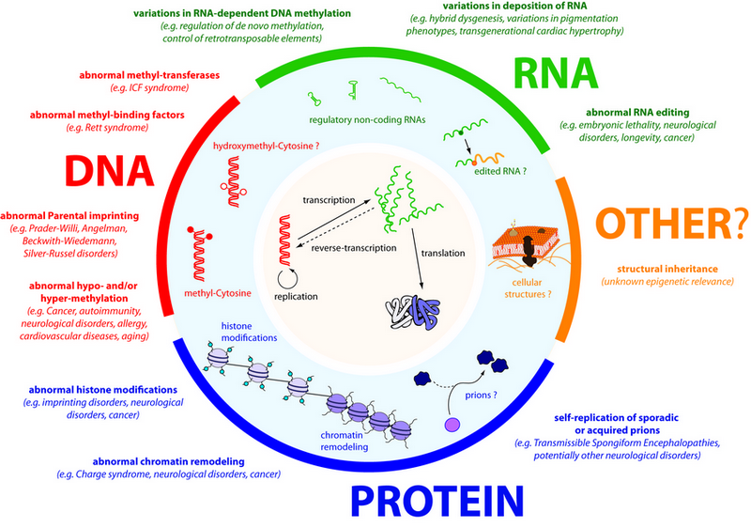
DNA methylation: best biomarkers for human diseases
Almost all disease showed methylation abnormal
Aging can be highly predicted by methylation clock
High sensitivity: single molecular with PCR
Stable in vitro without degradation
High tissue and status specificity
Change earlier than mRNA and protein
Easy to be assembled to a multi-disease panel

Slide 31
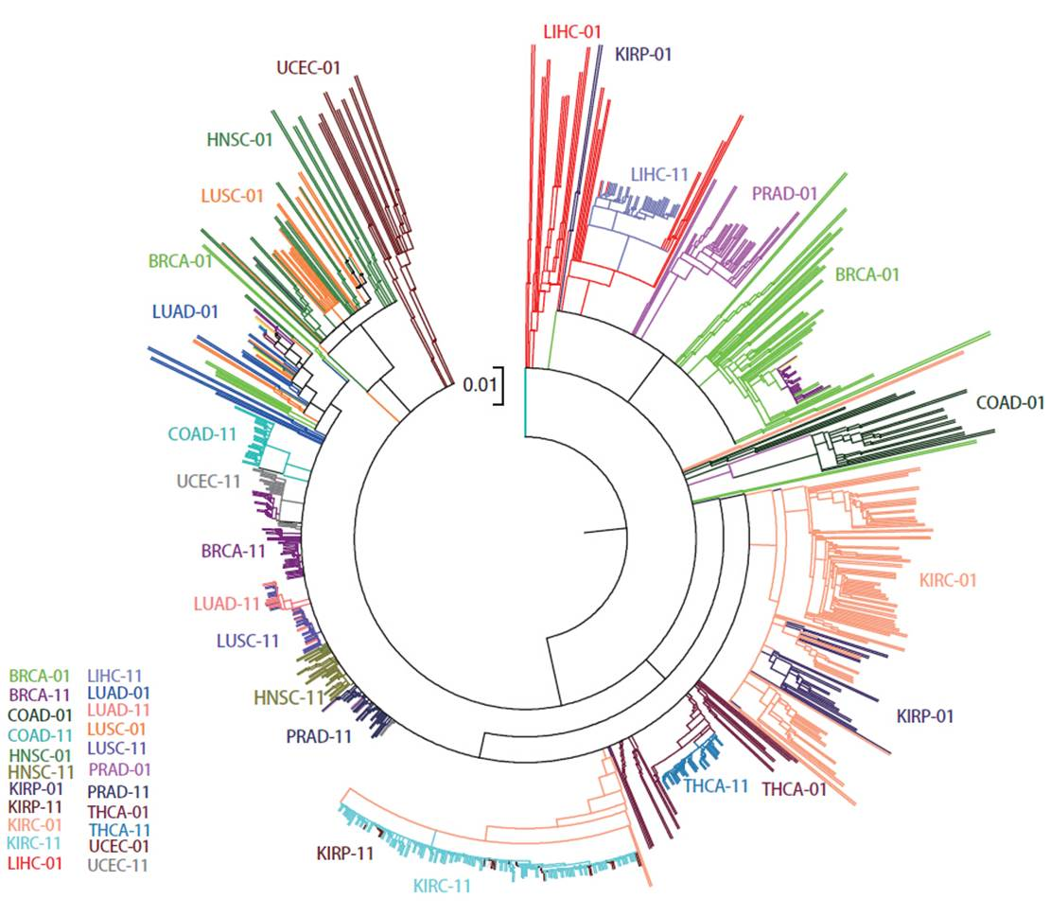
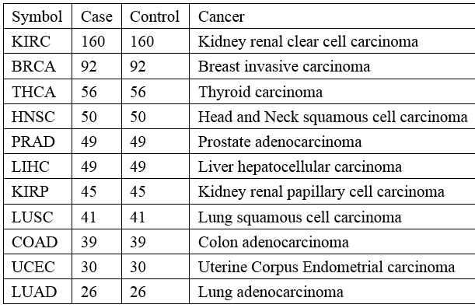
Unsupervised cluster analysis revealed cancer and normal similarity
Distance= 1-correlation
Cluster= mcquity
unpublished data

Slide 32
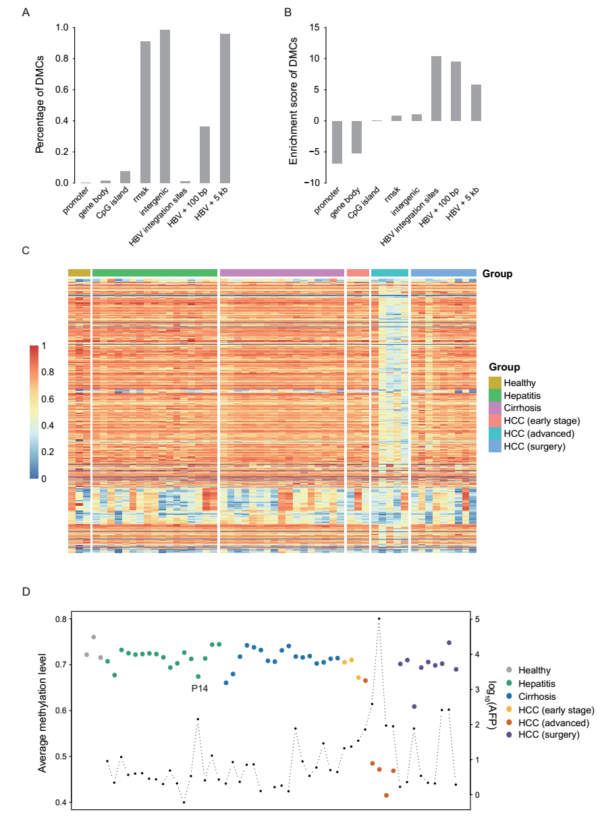
Cell-free DNA Methylation levels reveal long-term health status
unpublished data

Slide 33
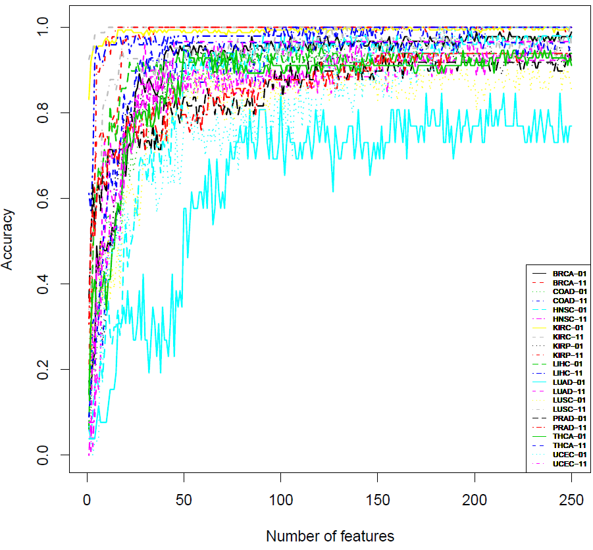
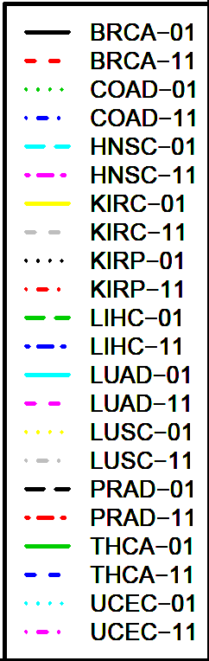
Multi-label Classification to Pan-cancer with Random Forest Method
 | Variable=25 |  |  | Variable=75
 | Sen | Spe | Acc | Sen | Spe | Acc
BRCA | 0.85 | 0.97 | 0.91 | 0.94 | 1.00 | 0.97
COAD | 0.72 | 0.85 | 0.78 | 0.92 | 0.89 | 0.91
HNSC | 0.58 | 0.72 | 0.65 | 0.94 | 0.90 | 0.92
KIRC | 0.99 | 1.00 | 0.99 | 0.99 | 1.00 | 0.99
KIRP | 0.84 | 1.00 | 0.92 | 0.91 | 1.00 | 0.96
LIHC | 0.87 | 0.96 | 0.92 | 0.92 | 0.98 | 0.95
LUAD | 0.27 | 0.73 | 0.50 | 0.58 | 0.85 | 0.71
LUSC | 0.63 | 0.93 | 0.78 | 0.78 | 0.93 | 0.85
PRAD | 0.78 | 0.82 | 0.80 | 0.86 | 0.84 | 0.85
THCA | 0.79 | 0.88 | 0.83 | 0.88 | 0.96 | 0.92
UCEC | 0.57 | 0.77 | 0.67 | 0.77 | 0.97 | 0.87
25-75 CpGs provide ~80% accuracy to 11 cancer and 22 status

Slide 34
Molecular stability and plasticity in biomarker identification
DNA
Hereditary material that encodes functional biological molecules
mRNA
Molecule that carries DNA “directions” for protein synthesis
Proteins
Primary functional and structural molecules for all biological processes
From static to dynamic biomarkers
one and done
repeat regularly
DNA methylation

Slide 35
Molecular stability and plasticity in biomarker identification
DNA
Hereditary material that encodes functional biological molecules
mRNA
Molecule that carries DNA “directions” for protein synthesis
Proteins
Primary functional and structural molecules for all biological processes
From static to dynamic measurements
one and done
repeat regularly
DNA methylation

Slide 36
LINE-1 COBRA Forward: 5’-TTGAGTTGTGGTGGGTTTTATTTAG-3’
LINE-1 COBRA Reverse: 5’-TCATCTCACTAAAAAATACCAAACA-3’
LINE1 -EF ATTTTATATTTGGTTTAGAGGG 359
LINE1 -ER ATCAAAAATCAAAAACCCACTT 360
LINE-IF TTTTATATTTG GTTTAG AG GG 361
LINE-IR-Bio [Btn]TCAAAAATCAAAAACCCACTT 362

Slide 37
